Slide 1






DEPARTMENT OF CSE (ARTIFICIAL INTELLIGENCE & MACHINE LEARNING)
ORGANIZES
COGNITIA-𝟚𝕂𝟚𝟞
404 - FOUND
Team Members: Sarweshwar Buddolla – 24N35A6609
Karthikeya Choudary – 23N31A6670 Krishnateja Kallem – 23N31A66D0
Idea Title :
Snap2Swachh
Click. Report. Reform.

Slide 2


Problem Statement
Greater Hyderabad Municipal Corporation (GHMC) is responsible for maintaining urban cleanliness . However, rapid population growth has significantly increased sanitation challenges across the city.
Citizen irresponsibility and negligence result in :
Illegal garbage dumping
Drainage blockages
Repeated waste accumulation
Core Issue:
Municipal authorities cannot monitor every street in real time, especially when repeated citizen negligence creates recurring problem zones.
Lack of real-time, geo-intelligent reporting system.
No AI-based hotspot location prioritization mechanism.
Cognitia-2k26 @MRCET

Slide 3
Proposed Solution
Snap2Swachh is an AI-powered civic intelligence system and dual-login civic engagement platform designed to address urban cleanliness issues caused by citizen irresponsibility and negligence. The system connects citizens directly with municipal authorities through a real-time geo-tagged reporting mechanism.
Cognitia-2k26 @MRCET

Slide 4
Citizens can snap photos or videos of unclean areas, with GPS automatically attached using inbuilt mobile location services.
Each complaint is stored centrally and verified before rewarding users with redeemable coins to encourage responsible behavior.
An AI engine clusters geo-tagged reports to detect recurring garbage and sanitation hotspots.
GHMC officials access a secure dashboard with Open street Maps(OSM) heatmaps to prioritize high-risk zones.
By combining citizen participation, AI analytics, and incentives, Snap2Swachh promotes accountability and sustainable urban cleanliness.

Slide 5
How Our Solution Solves the Problem
Converts citizens into smart sensors.
AI clusters reports by location.
Detects recurring garbage hotspots.
Prioritizes areas with highest frequency.
Encourages participation using rewards.

Slide 6
Key Features
Dual login system
One-click complaint submission
Geo-tagging (no manual location entry)
AI hotspot detection
Reward & redemption system
Real-Time Status Tracking like issue sumitted,verified,in progress ,resolved
heatmap for officials
Anti-fake image & duplicate detection

Slide 7
Tools & Technology Used
Frontend: Flutter (Dart)
Backend: Supabase (Backend-as-a-Service)
Database: PostgreSQL (hosted via Supabase)
Storage & Authentication : Supabase Storage and Auth
AI Algorithm: Marker Cluster algorithm and Haversine Distance Algorithm Geo Services: OpenStreetMap (OSM)(for landmark mapping)
Version Control: Git & GitHub
Development Environment : Android studio
Cognitia-2k26 @MRCET

Slide 8
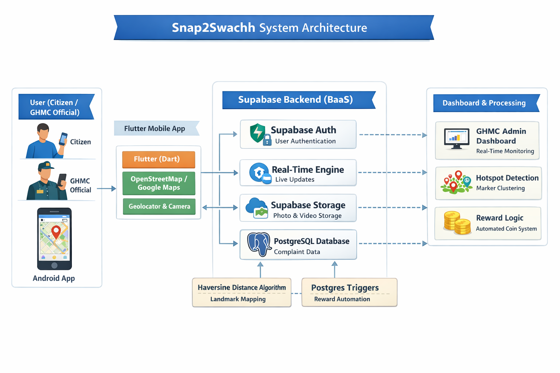

Slide 9
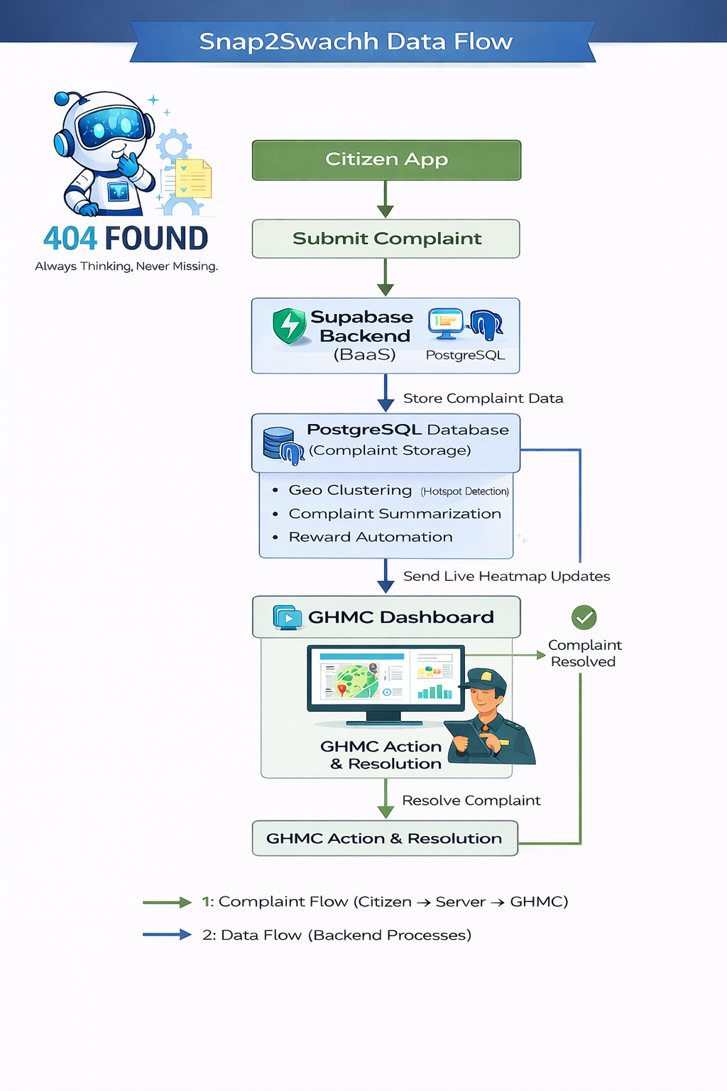

Slide 10
Results / Outcome
Expected Impact
Reduced impact of citizen negligence
Increased civic responsibility
Faster garbage clearance
Identification of recurring dumping zones
Improved urban sustainability
Cognitia-2k26 @MRCET

Slide 11
Real-World Application
Implementation in Hyderabad under Smart City initiatives
Expansion to other municipalities in India
Integration with Swachh Bharat Mission
Rewards can be redeemed as
-Metro/buss tickets
-Challan
-GHMC tax discount coupons

Slide 12
Innovation & Future Scope
What Makes Snap2Swachh Unique?
AI-driven hotspot intelligence
Behavior correction through reward model
Role-based secure governance access
Geo-analytics for sustainable planning
Designed for low-end devices
Cognitia-2k26 @MRCET

Slide 13
Future Enhancements
YOLO-based automatic garbage detection.
IoT smart bin integration
Updated Citizen leaderboard system
Multilingual Voice Reporting

Slide 14
Conclusion
Snap2Swachh transforms citizen responsibility into AI-driven urban intelligence for sustainable and cleaner cities.
Open for Questions
Cognitia-2k26 @MRCET

Slide 15
Thank You
Cognitia-2k26 @MRCET

